Slide 1
Home Loan System
Barclays Post Grad Induction

Slide 2
Application Overview
Applicant can apply for a loan who has a bank account.
Bank (system) can approve or reject the loan application based on some defined criteria.
Once the loan has been approved, an applicant can:
Keep track of loan payments.
Either via monthly payment, pre-payment, or fore-closure to the bank.
Bank account holder can see the status that the system automatically updates the log once the payment is done.

Slide 3
Features – Loan Application
Bank account holder can apply for the loan by filling out the application form.
This application form is reviewed by the bank and an approved/reject decision is made based on some criteria.
Criteria through which the application is accepted:
50*monthlySalary > loanAmount
Status is updated in the bank system.
If the application is approved, then loan account is created and assigned to the account holder.
EMI’s are calculated and being available to the account holder.

Slide 4
Features – Payment Method
Monthly Payment
Payment is done as per the monthly EMI calculated by the bank.
Pre-payment
Account Holder can make a partial prepayment of a loan of a minimum of 3 times the monthly EMI.
Paid amount for the prepayment month will be adjusted against the outstanding balance.
Then subsequent Prepayment schedule & New EMI, Principal, Interest, outstanding from prepayment month onwards recalculated on the new outstanding amount with other parameters remaining same.
Fore-closure
Minimum 3 months EMI should be paid after which the bank account holder can apply for full loan payment at once.
Once the payment is complete all the remaining EMI status changes to ‘Canceled’ and the loan status is updated to ‘Closed’.

Slide 5
Features – Automatic Payment Calculation
EMI Calculation
It is calculated based on the amount of loan approved by the bank/ system to the user.
New EMI amount is calculated automatically if the account holder pre-pays some amount of the loan.

Slide 6
Assumptions
User is a valid Bank Account Holder.
Assuming that the account holder has a good credit score.
One has a valid source of income.

Slide 7
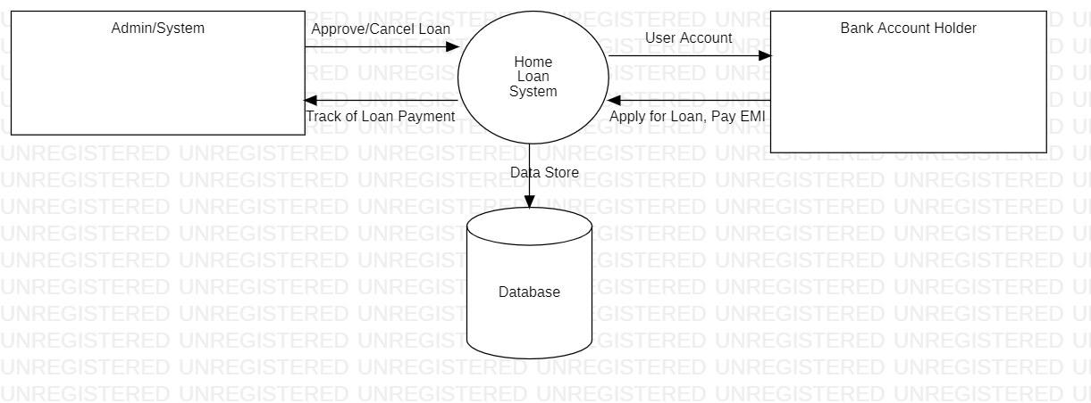
The Architecture of the System

Slide 8
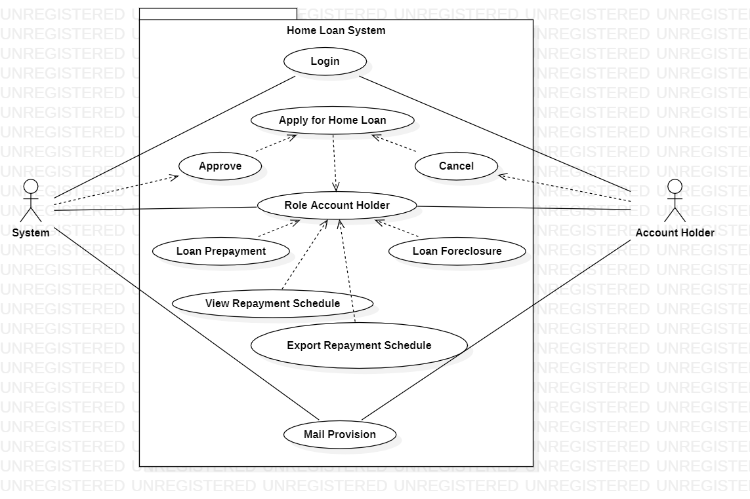
Use Case Diagram

Slide 9
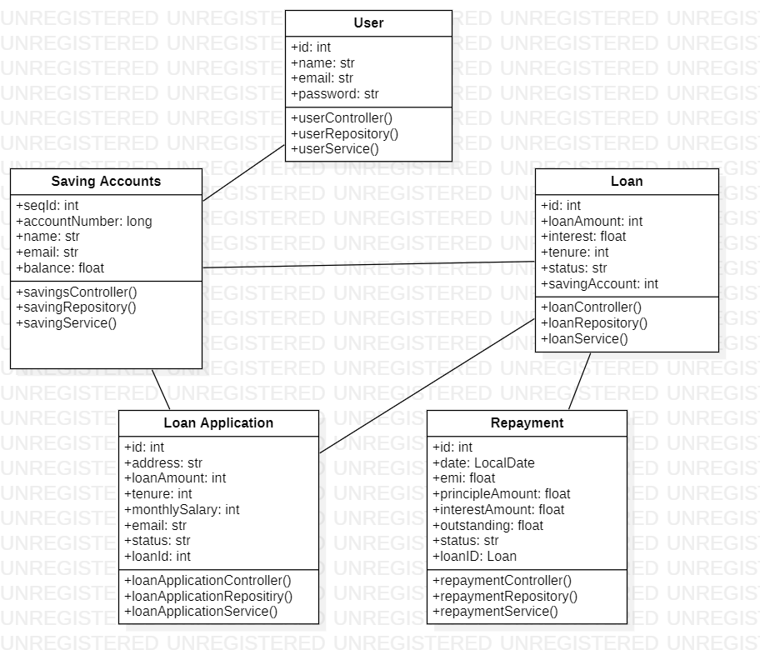
Class Diagram

Slide 10
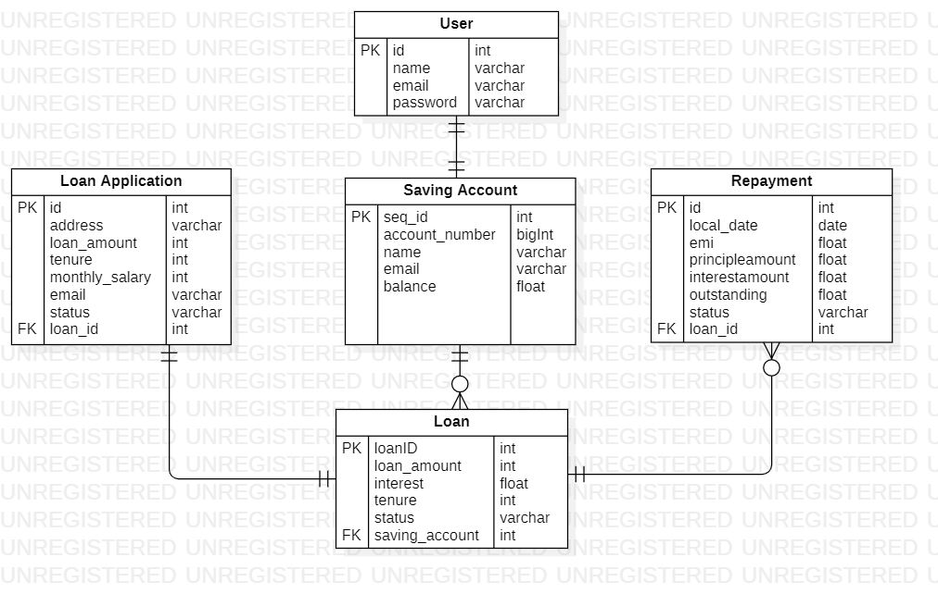
DB Model

Slide 11
The Process
Backlog Refinement:
We have included task-level jobs such as stories and defects.
Discuss each other’s thoughts based on the requirement and make a cumulative story.
Add or remove user stories according to the requirements.
Splitting user stories into priorities and defining sprints.
Sprint Planning:
Identify tasks for the selected stories
Distribute stories across the table.
Hourly Stand-up:
Story review and bug fixing.
Discuss other stories, any requirement blockage, and the next task to be done.
Review/Demo:
Checked the progress of stories.
Discussion of any new feature.
Informal talk with the team to open up their thoughts.
Retrospective:
Every 3-hour project meeting.
Planning production.

Slide 12
Additional enhancements - additional enhancements that could be made?
UI for system and Bank Account holder.
Login Page
Email notifications
Authentications

Slide 13
Project Dynamics -How did your team divide up the work?
Team member 1: Aanchal Kedar (Leader)
Service implementation
Team member 2: Heena Bhavnani
Payment feature implementation
Team member 3: Anshika Gupta
Loan application implementation
Team member 4: Abhishek Kumar
Loan object implementation
Team member 5: Aman Tiwari
User and account holder implementation
Team member 6: Devansh Chaturvedi
Diagrams and Testing
Team member 7: Himavamsi G
Database Management
Team member 8: Ashish Shukla
Git implementation
Team member 9: Ruchir Agrawal
API testing in Postman and controller implementation

Slide 14
Lessons Learned
To put your thoughts in team gatherings.
Before proceeding, everyone should understand the stories.
How to pick important and useful information from the problem description.
How to appreciate others’ thoughts and add yours at the same time to enhance the project.
Write down whatever doubts come to your mind and put it forward in the scrum meeting, it might lead to a new feature or fix a bug.

Slide 15
Product Demo

